Slide 1
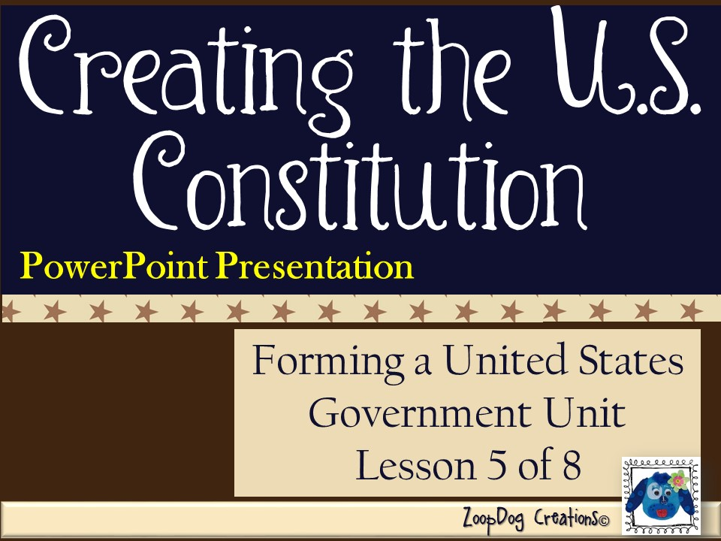

Slide 2
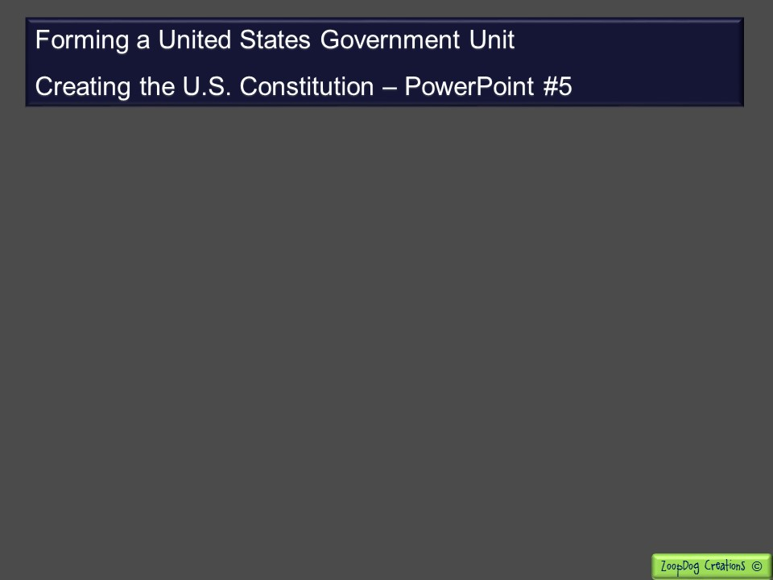
VOCABULARY Republic – Separation of powers – Representative government – John Locke – Baron de Montesquieu – Magna Carta – English Bill of Rights –

Slide 3
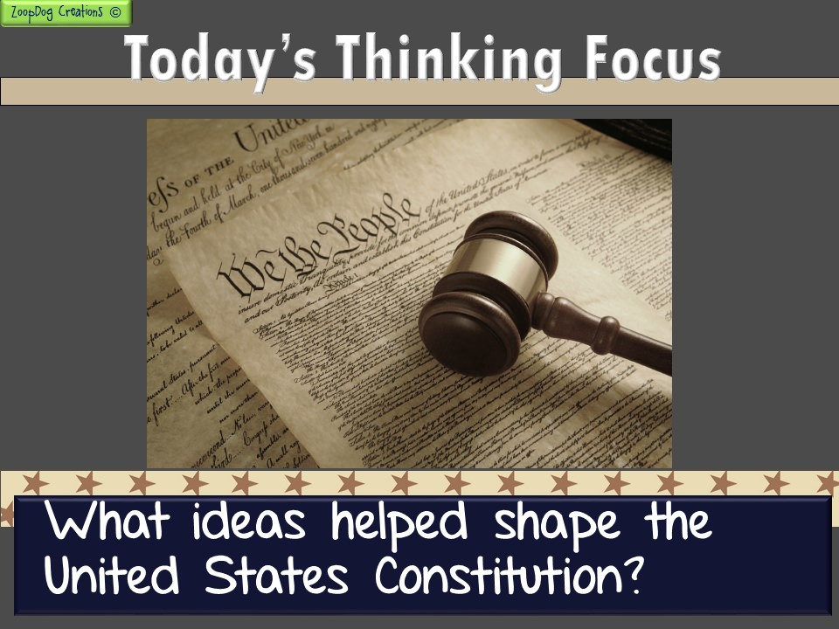

Slide 4

And the story continues . . .
An economic depression hits, states are fighting and the government is too weak to do anything about it!
The Continental Congress tries to create a new government, but states fight over how it should be structured.
The Virginia and New Jersey Plans are created but causes more fighting. The Great Compromise created by Roger Sherman finally settles the dispute.
Northern and southern states begin fighting over slavery. The Three-Fifths Compromise allows slaves to be counted as 3/5th of a person.

Slide 5
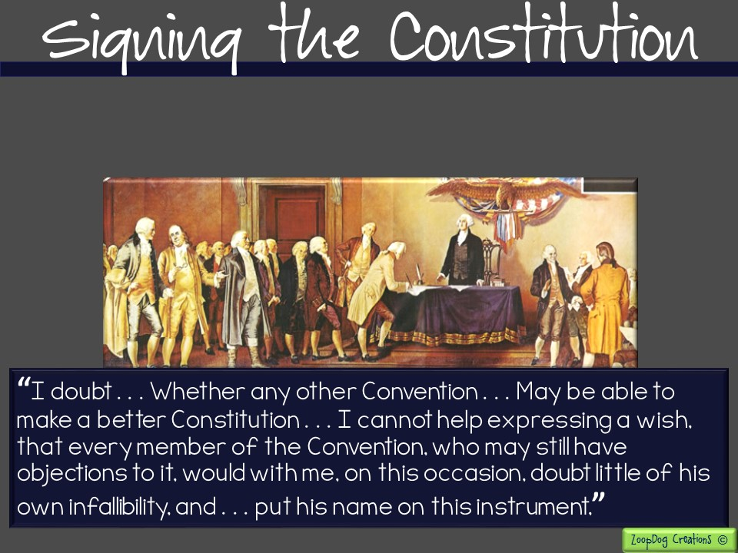
On September 17, 1787, the Constitution was ready. Gathering for the last time delegates listened quietly as Benjamin Franklin rose to plead that the document be accepted:

Slide 6
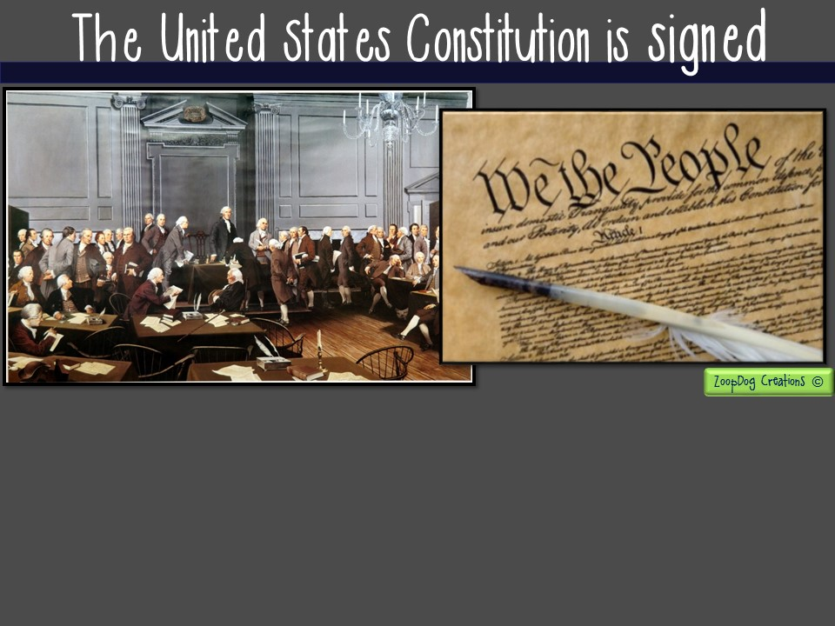
One by one, delegates came forward to sign the document. Of the 42 delegates remaining in Philadelphia, 39 signed the document.
Edmund Randolph and George Mason of Virginia, along with Elbridge Gerry of Massachusetts refused to sign. They felt the new Constitution gave too much power to the national government.

Slide 7
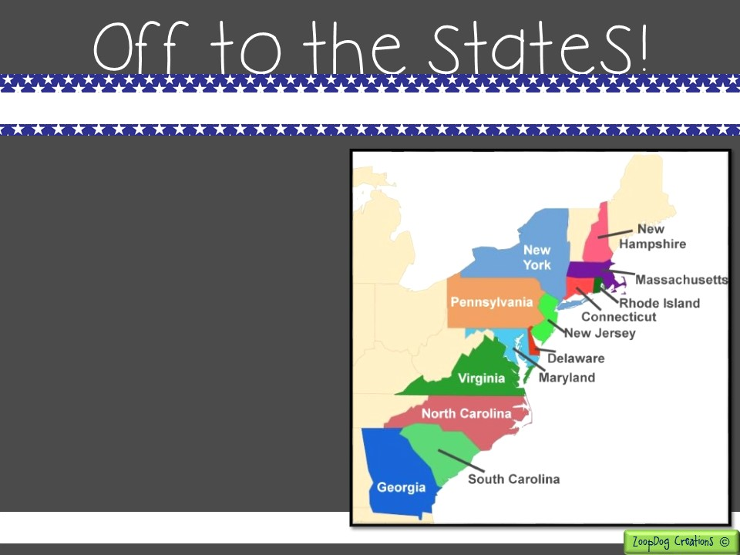
The Constitution required each state to hold a state convention to decide if the plan for the new government should be accepted.
Before that occurred, the new Constitution was discussed and debated in all the states.
Once 9 of the 13 states endorsed it, the Constitution would become the law of the land.

Slide 8
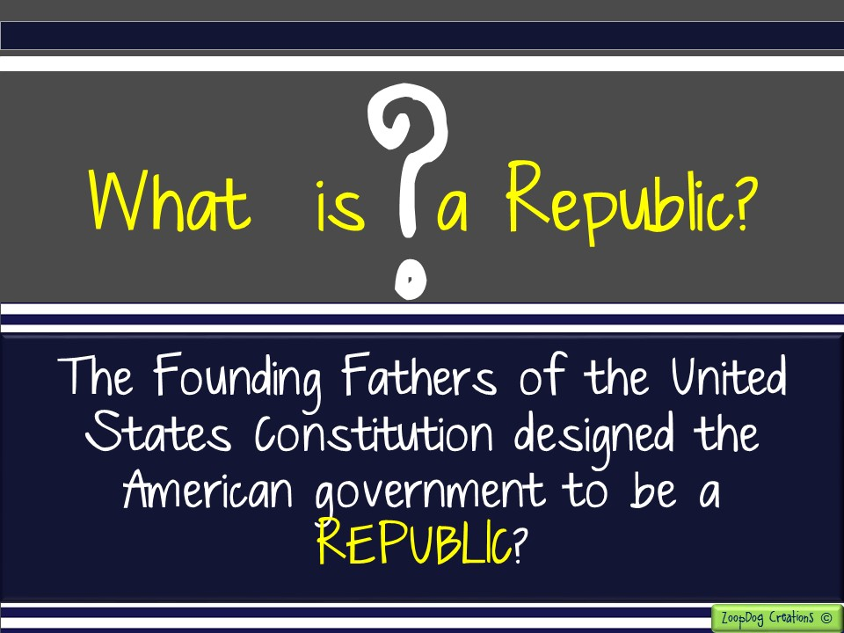

Slide 9
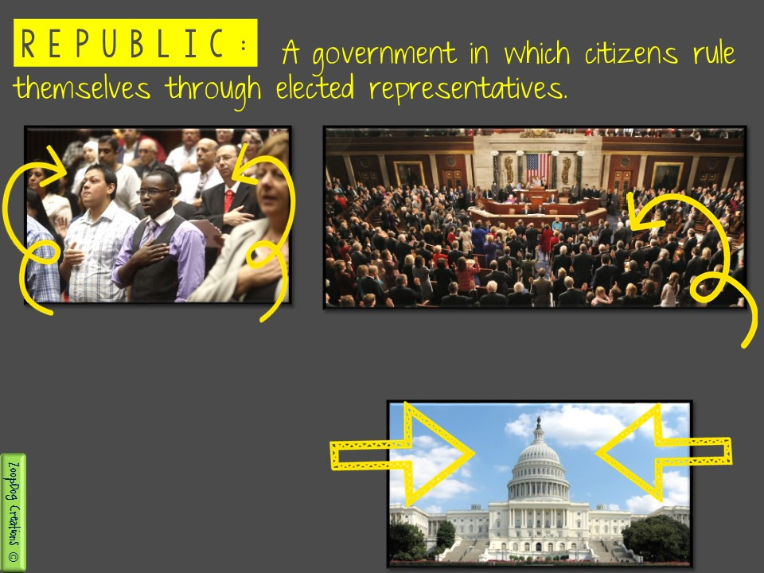
These people, average United States citizens, vote and elect representatives to speak for them in Congress.
These are the representatives the PEOPLE chose to represent them. The representatives create bills and pass laws for the American people.
This is Capitol Hill located in Washington D.C. It is where the representatives go to work for the American people.

Slide 10
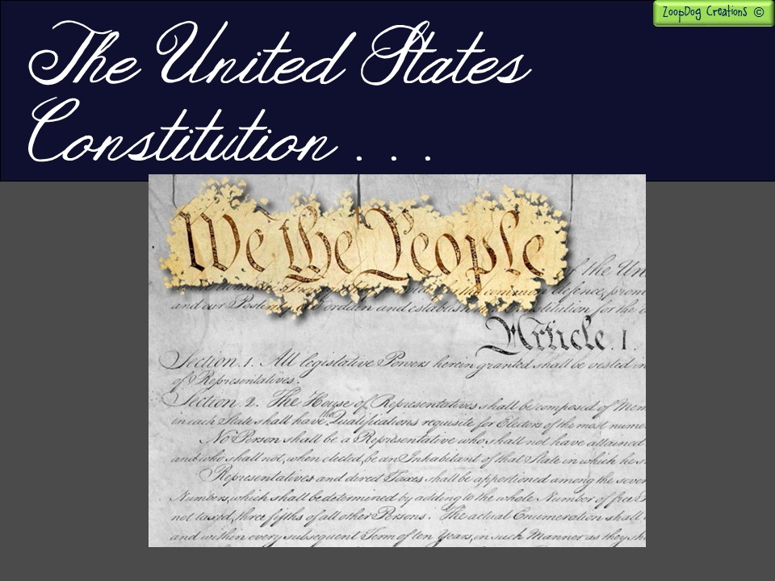
The United States Constitution outlined a new government that would be strong and protect the American people from excessive power (such as from a king or dictator).
The United States Constitution prevented any ONE branch of government from becoming too powerful.

Slide 11
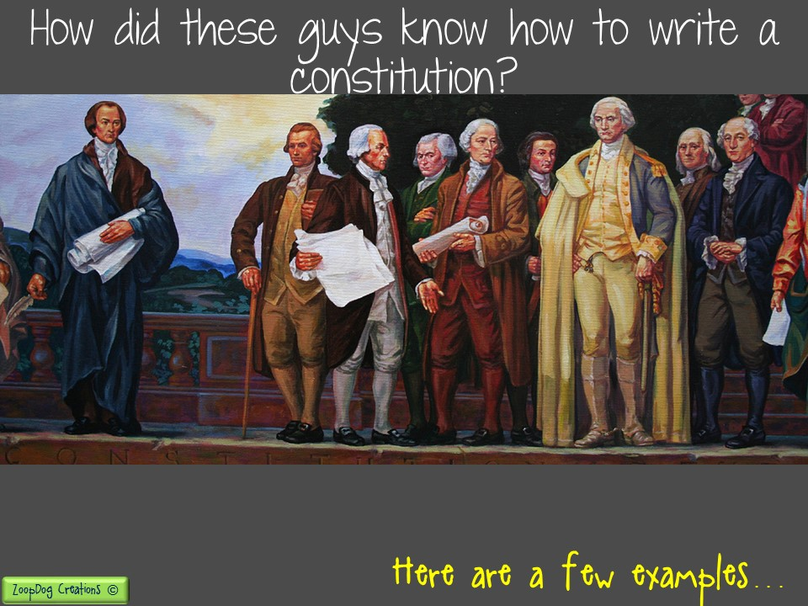
The framers of the Constitution were well educated men. They were familiar with the traditions of Britain and the American government.
Many of them had read the latest works of Europe’s leading political philosophers (educated thinkers!).
In creating the Constitution, the framers made good use of their rich knowledge and experience. Many of the ideas in the Constitution were not the founding fathers’ original ideas.
They were copied from other ideas written way before the United States Constitution was written.

Slide 12
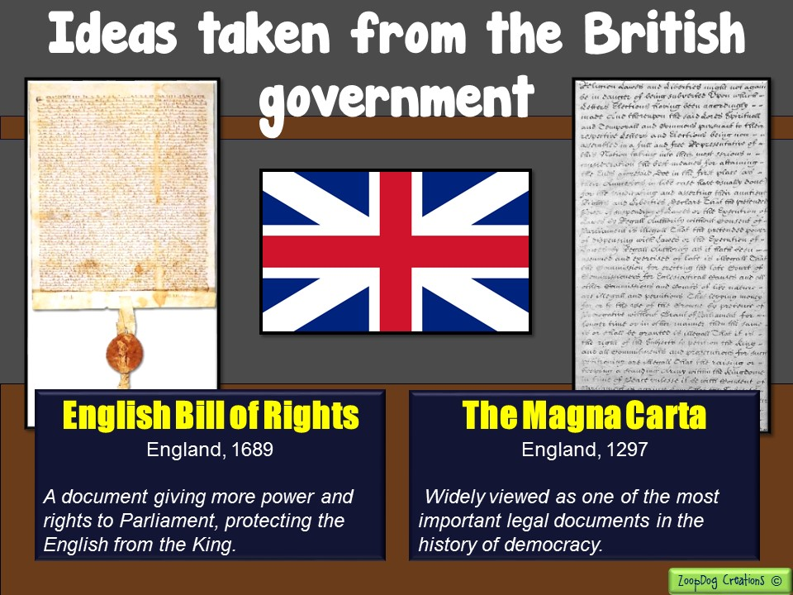

Slide 13
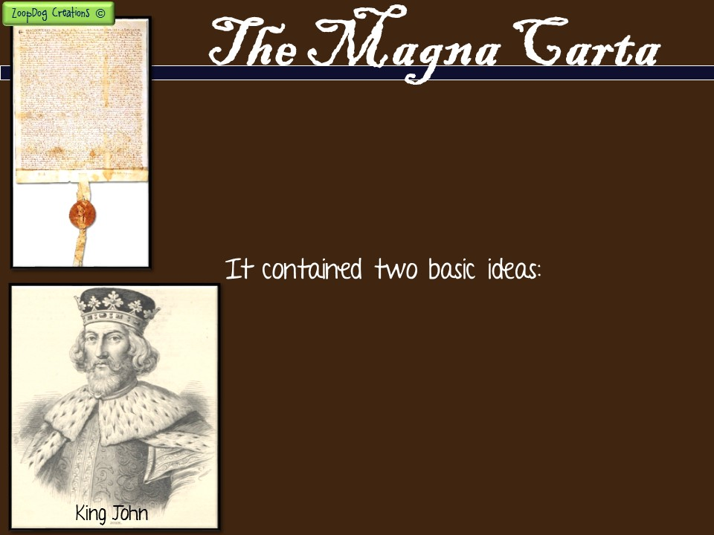
What is it?
A first document of its kind written in 1297 by the English people to limit the power of the English King.
It stated that English nobles (wealthy men) had certain rights.
It stated that the English king was not above the law, and he had to obey the rules!
Example: The English King John agreed NOT to raise taxes without first consulting the Great Council of Nobles and church officials (what became known as Parliament).

Slide 14
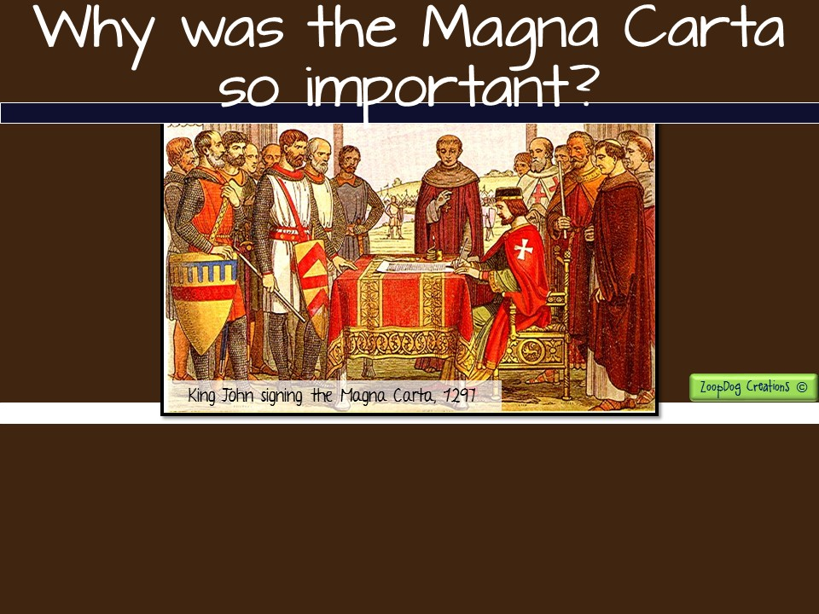
In the Magna Carta, King John was also forced to recognize that citizens had legal rights. One of the most important of these was the right to a trial by jury.
According to the Magna Carta, a person could not be arrested or imprisoned unless convicted of a crime.

Slide 15
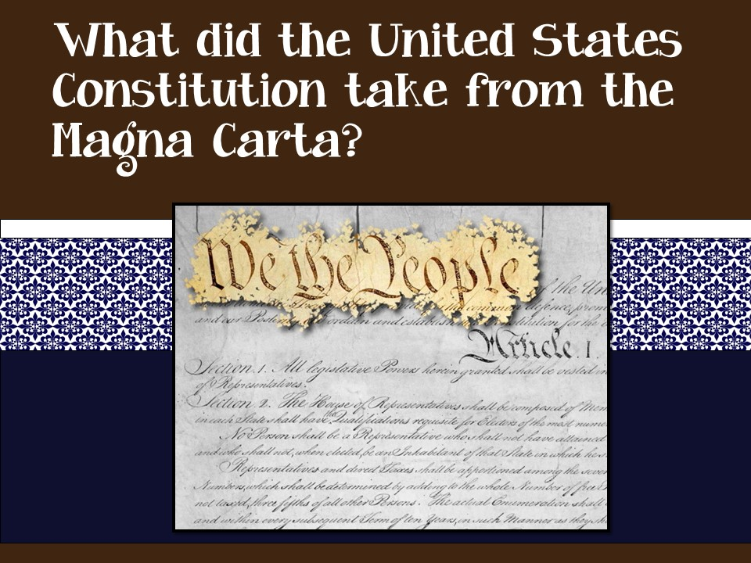
Citizens have certain rights.
The ruler (president) has to obey the law.

Slide 16
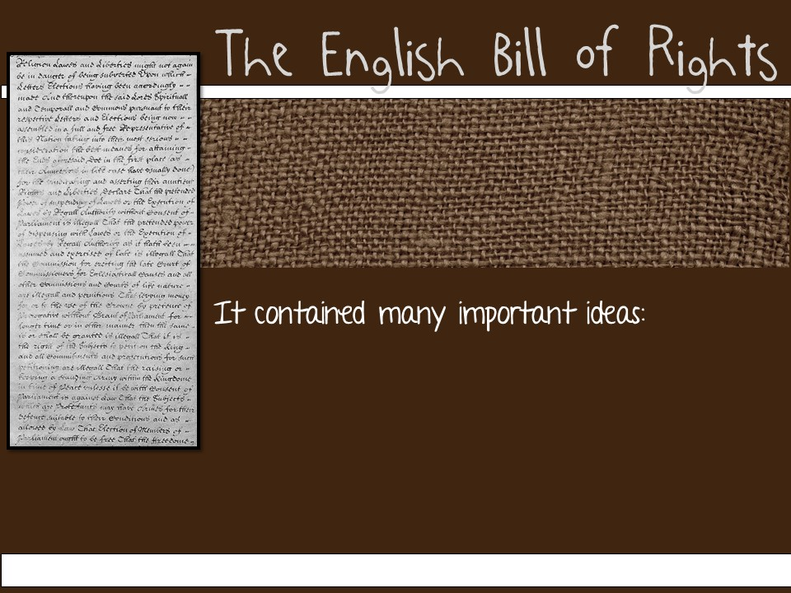
What is it?
In 1689, the English Bill of Rights went a step further than the Magna Carta in limiting the king’s power!
The PEOPLE have the right to a trial by jury.
No unusual, cruel, or unjust punishment.
Citizens can own a gun.
Citizens have to be charged with a crime before being held in prison (Habeas Corpus).

Slide 17
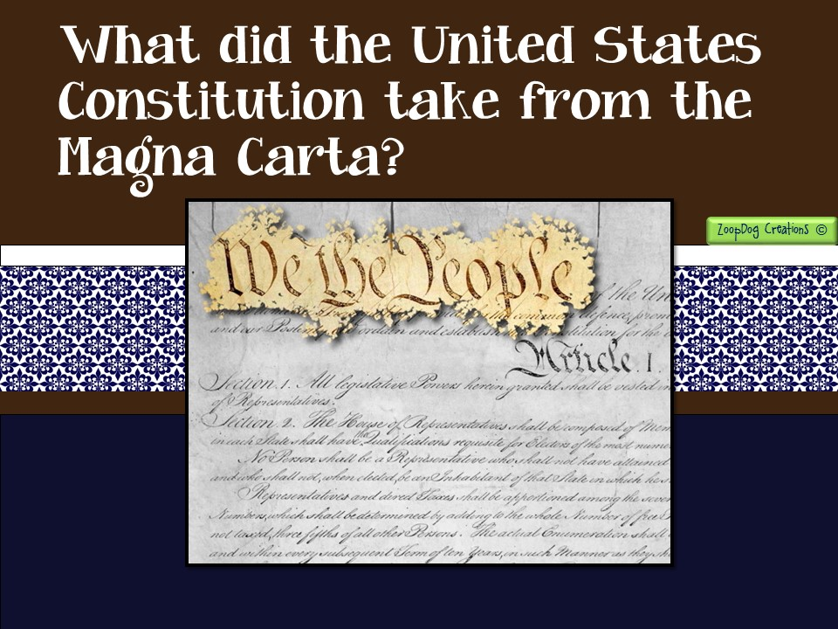
A Bill of Rights was included in the United States Constitution detailing the “rights” of every citizen.
Citizens have the right to own gun.
Citizens have the right to a fair trial.
Citizens can’t be put in jail without being charged with a crime.

Slide 18
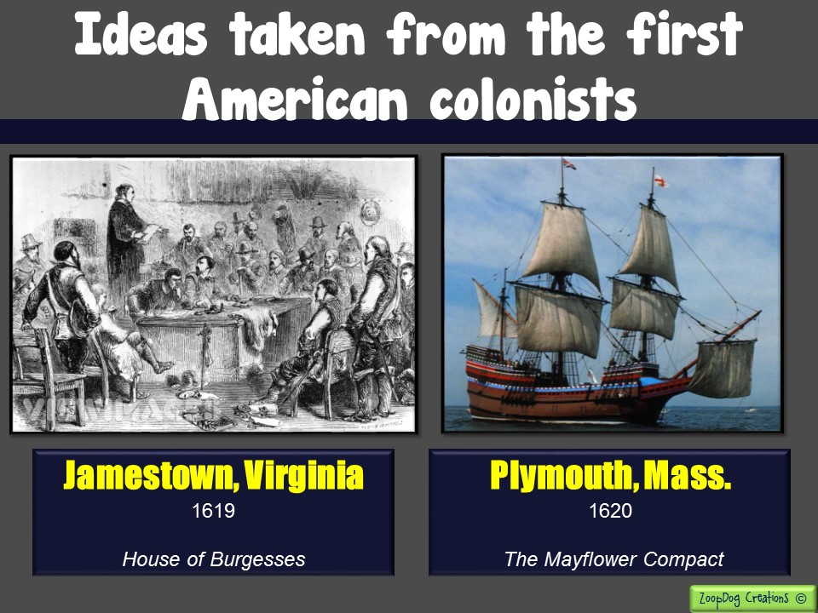

Slide 19
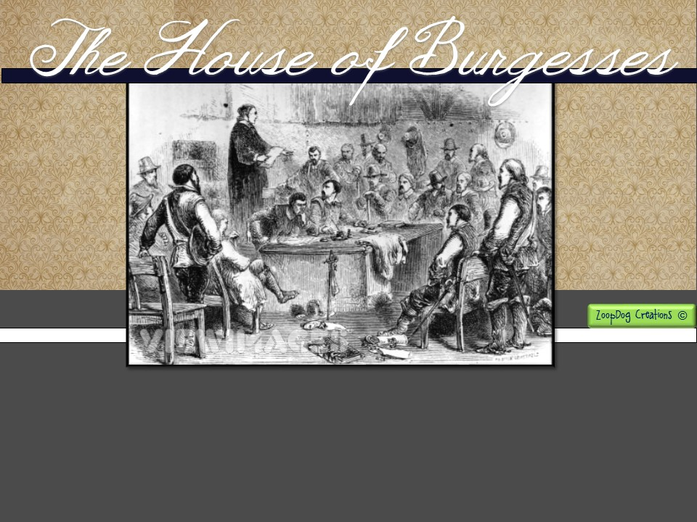
What is it?
In 1619, the Virginia colonists at Jamestown set up their local government.
It was a representative government = run by the PEOPLE (not a KING!)

Slide 20
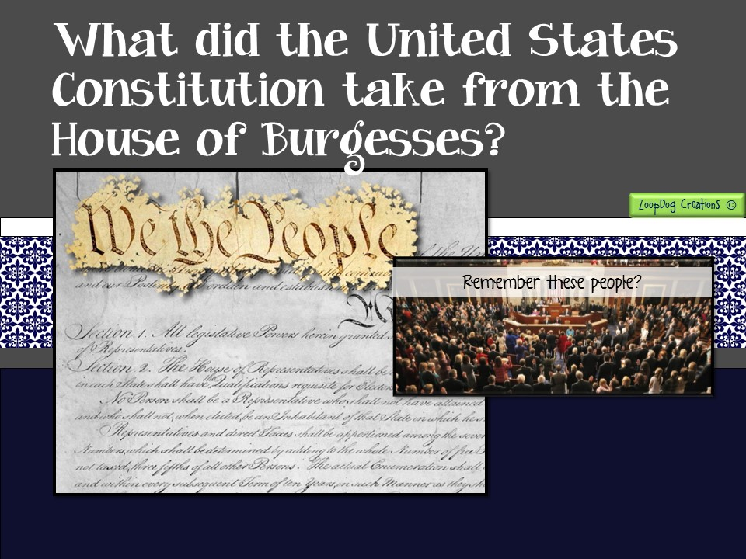
The United States set up a government based on representatives elected BY THE PEOPLE. It is called a representative government.
The people elect representatives to Congress in the Senate and the House of Representatives to speak for them.

Slide 21
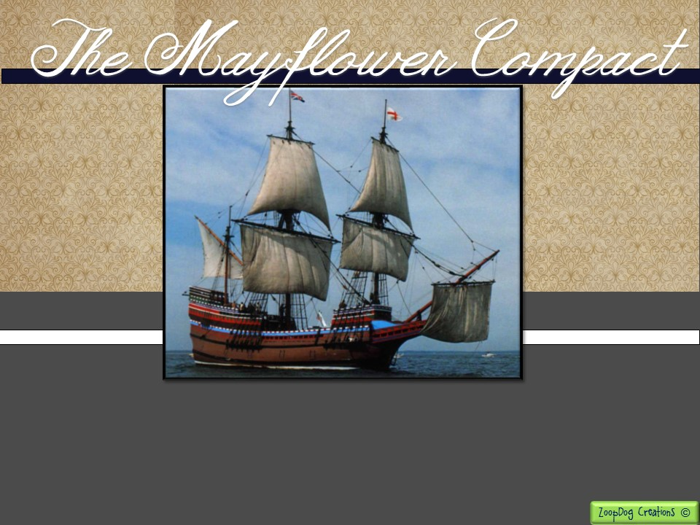
What is it?
The first document on the American Continent that detailed the powers and limits of government.

Slide 22
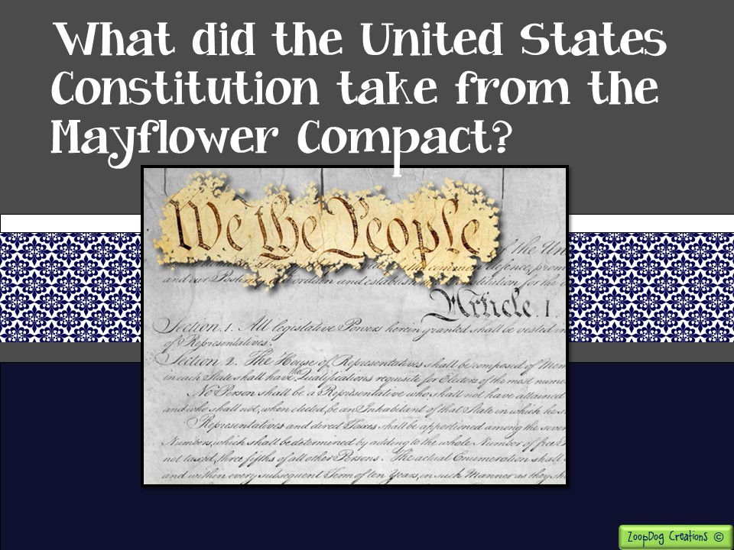
The idea of writing an “instruction book” on how to run the government.
Writing down the powers and limits of government.

Slide 23
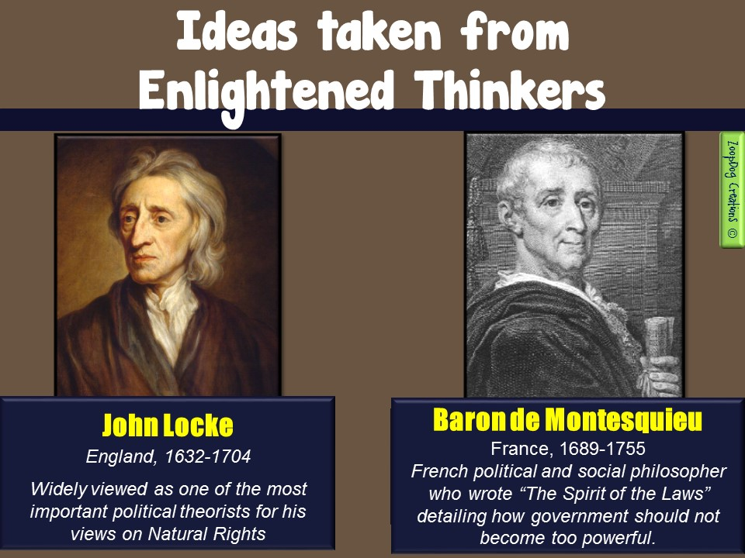

Slide 24
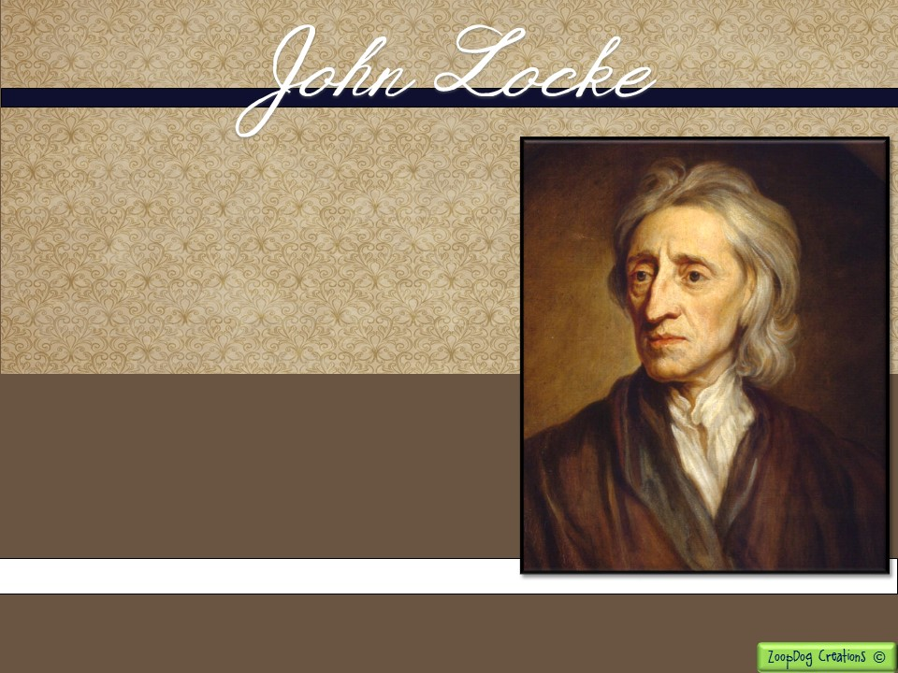
What did he believe?
All people have natural rights -“life, liberty, and property.”
Government is an agreement between the ruler and the ruled.
Ruler = protector and enforcer of laws.
If ruler fails at this, the people have a right to rebel.

Slide 25
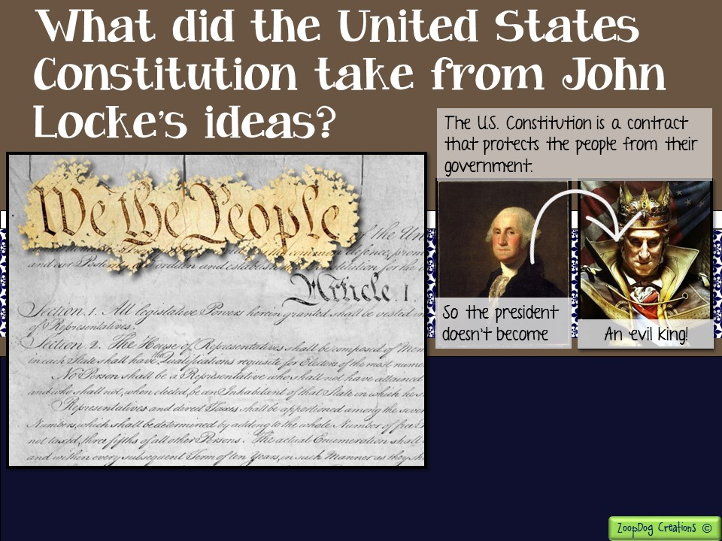
The people’s “natural rights” must be protected.
Governmental power must be limited.
The Constitution is a “social contract” between the people and their government.

Slide 26
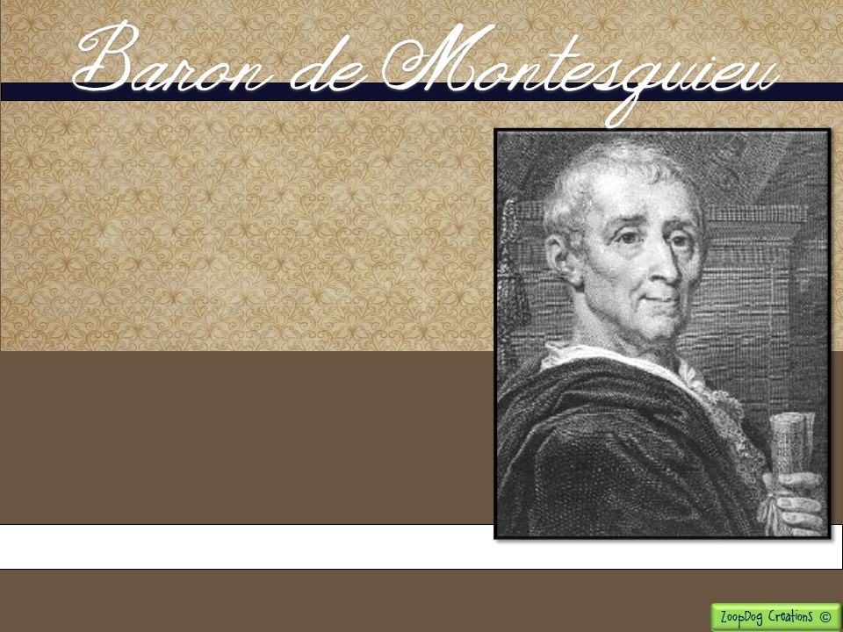
What did he believe?
SEPARATION OF POWERS The government must be divided among three separate branches: the legislative, executive and judicial.
These three branches check one another so no one branch gains too much power!

Slide 27
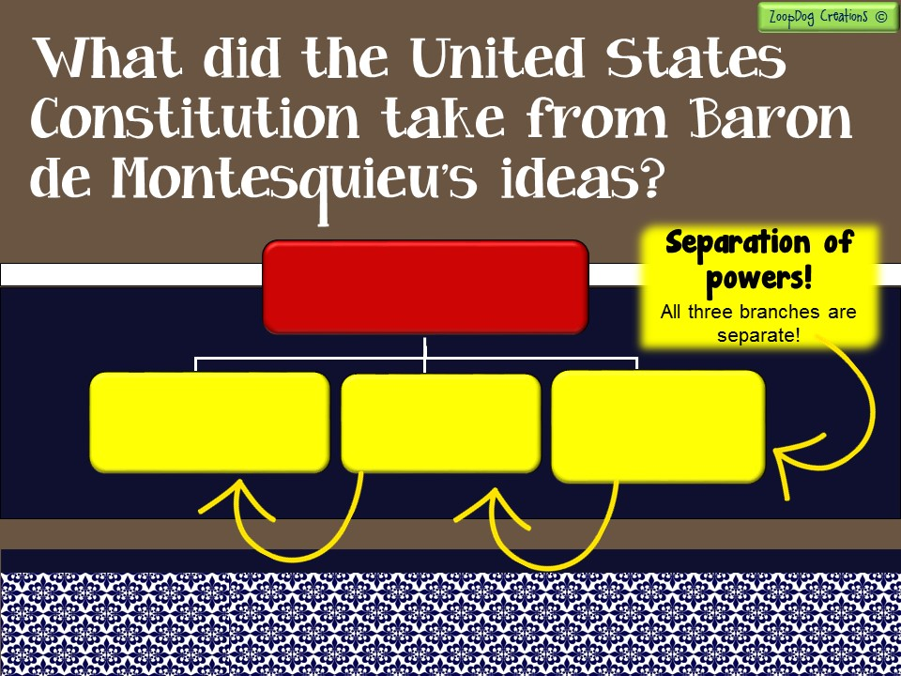
Federal Government
Legislative Branch
“Congress”
- Creates and passes the laws -
Executive Branch
- Carries out the laws -
Judicial Branch
- Decides if laws are fair -
Limiting the powers of government by creating three branches so no one branch becomes too powerful.

Slide 28


Slide 29
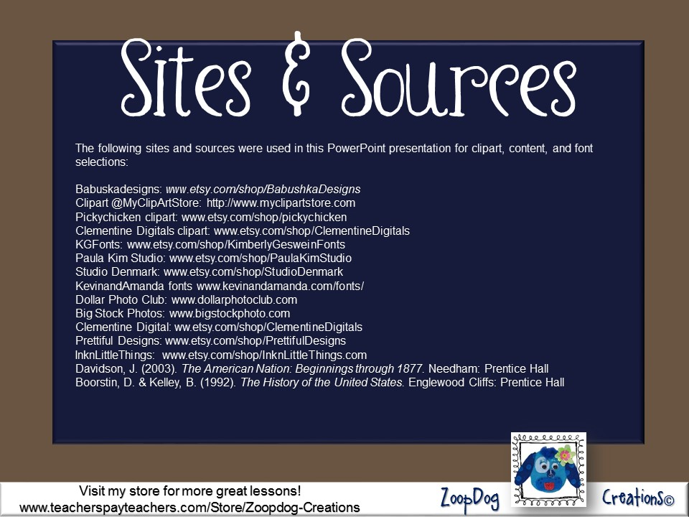

Slide 30
